Slide 1
APML CA2
Zheng Yimin / NSDAI -01 / P7053148

Slide 2
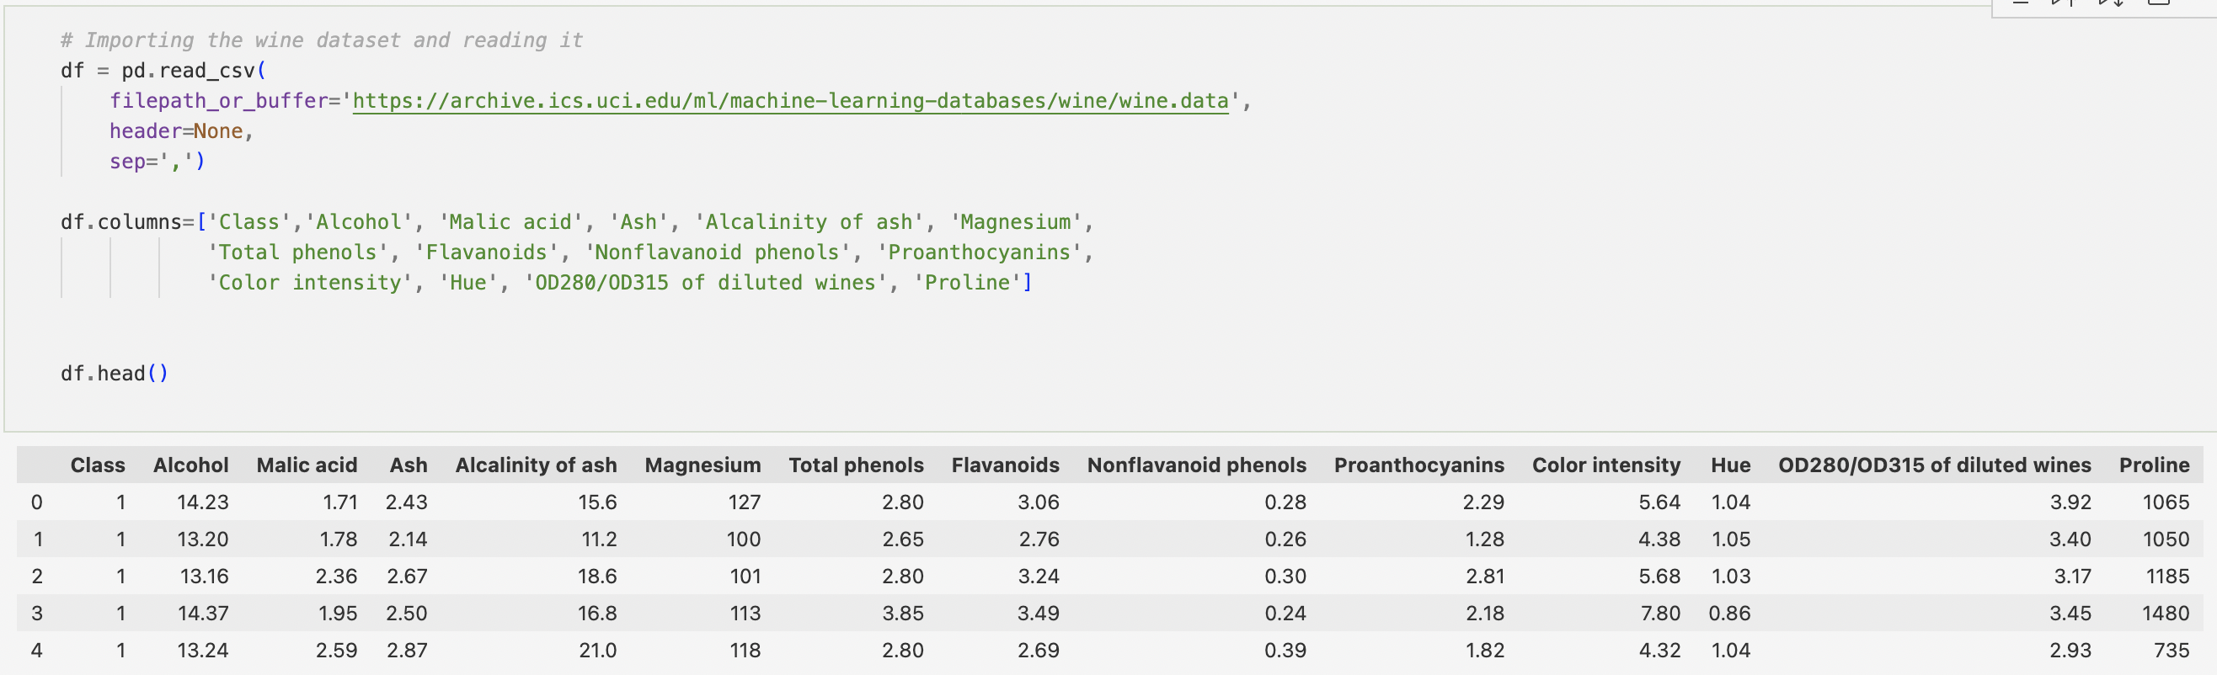
P A R T A : U N S U P E R V I S E D L E A R N I N G
IMPORT DATA
EDA
PCA
K-MEANS
GMM
HIERACHICAL CLUSTERING
EVALUATION

Slide 3
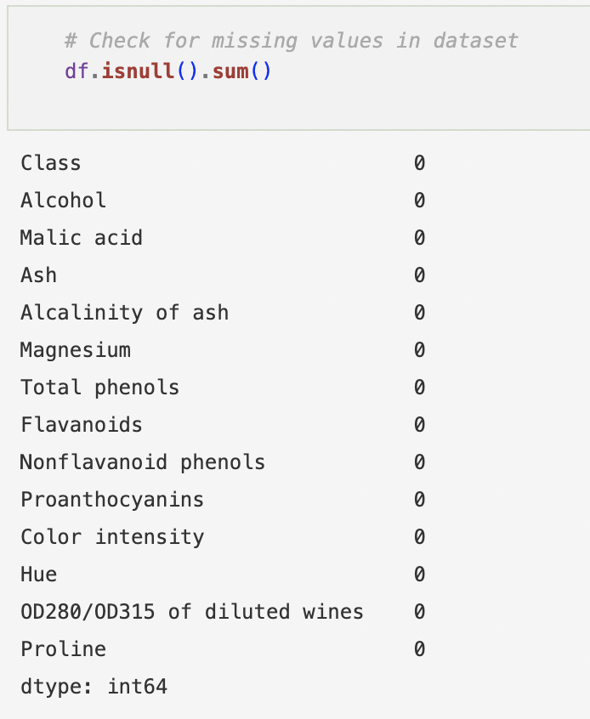
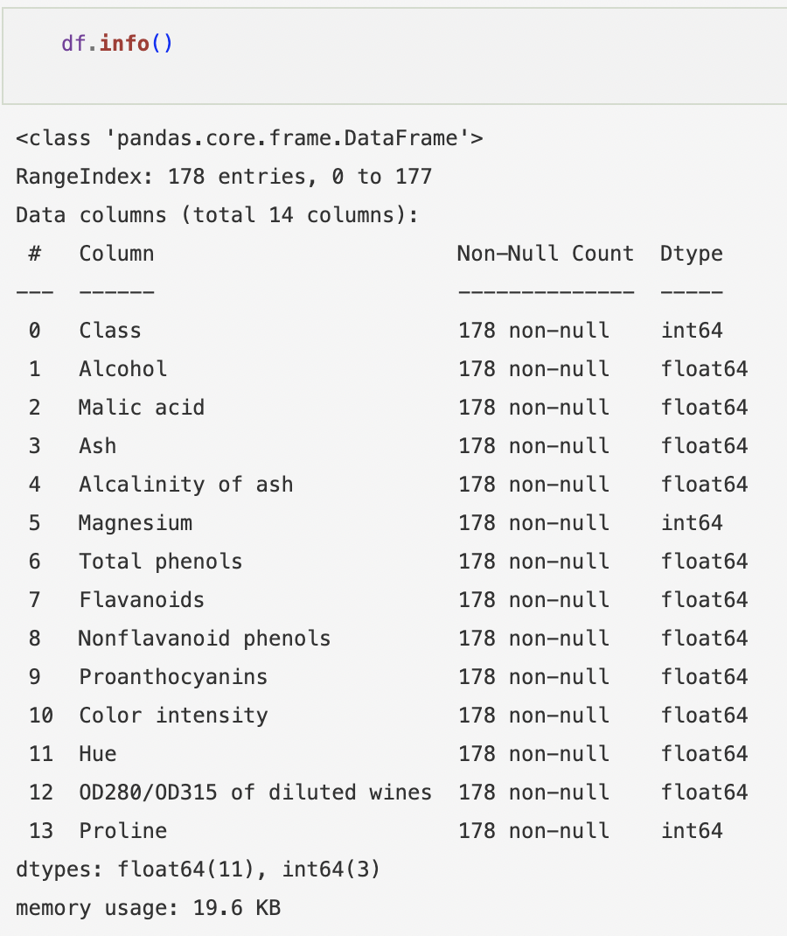
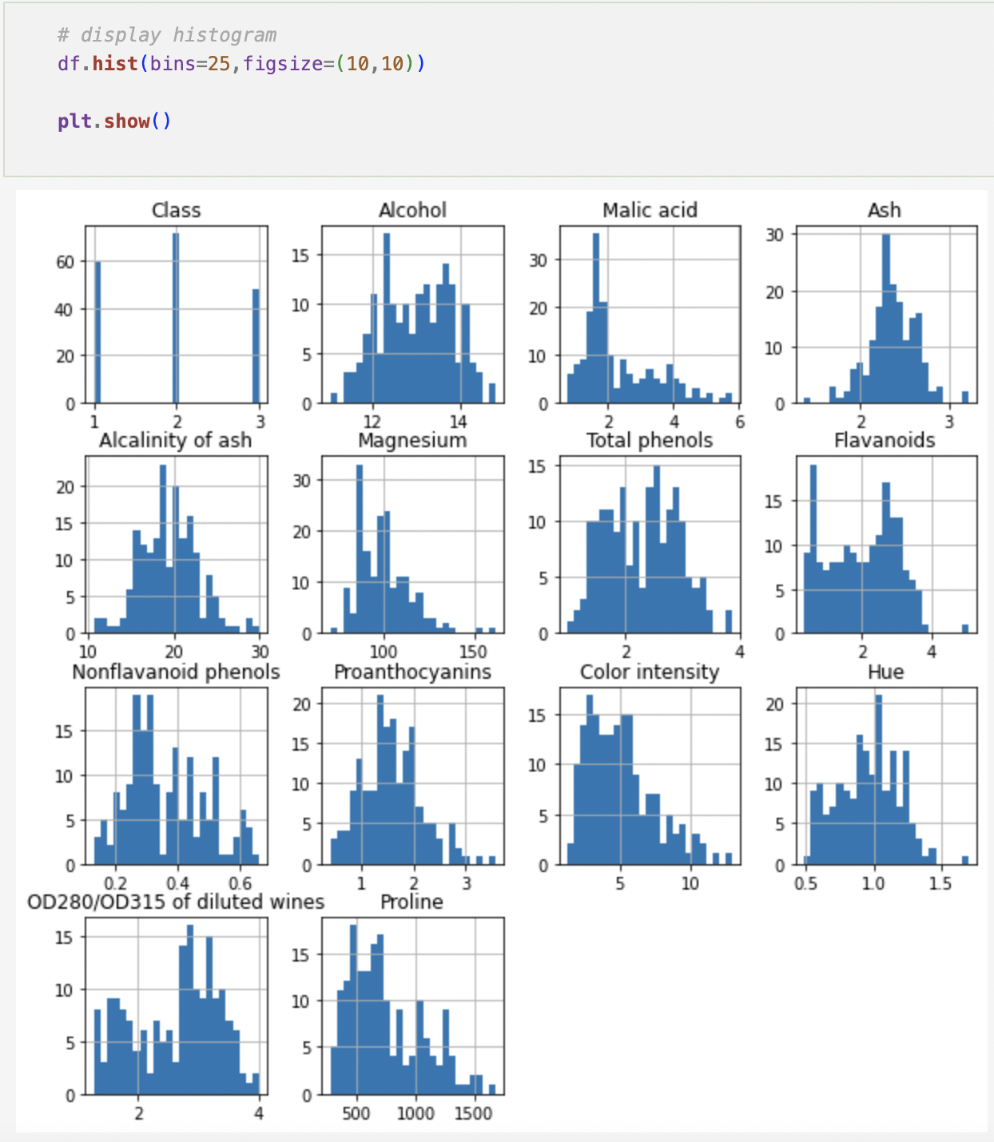
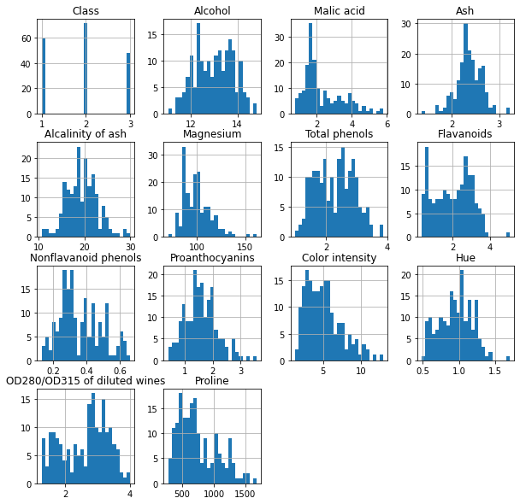
P A R T A : U N S U P E R V I S E D L E A R N I N G
IMPORT DATA
EDA
PCA
K-MEANS
GMM
HIERACHICAL CLUSTERING
EVALUATION

Slide 4
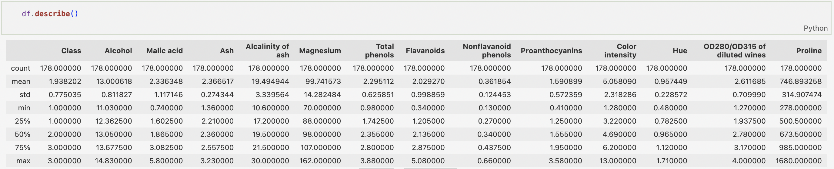
P A R T A : U N S U P E R V I S E D L E A R N I N G
IMPORT DATA
EDA
PCA
K-MEANS
GMM
HIERACHICAL CLUSTERING
EVALUATION

Slide 5
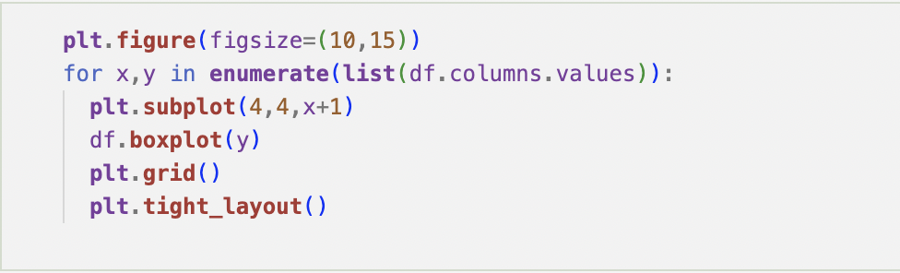
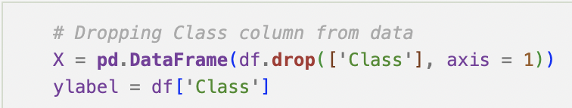
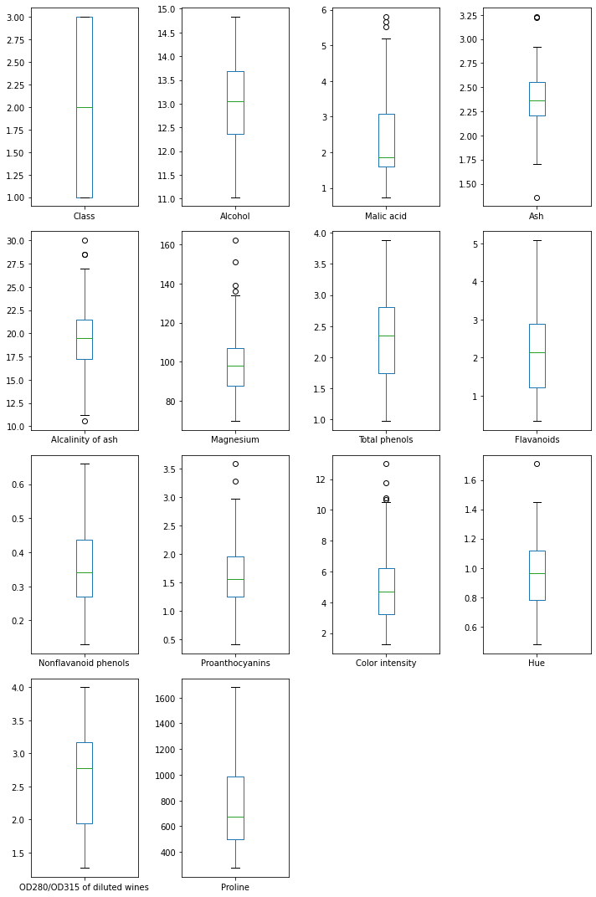
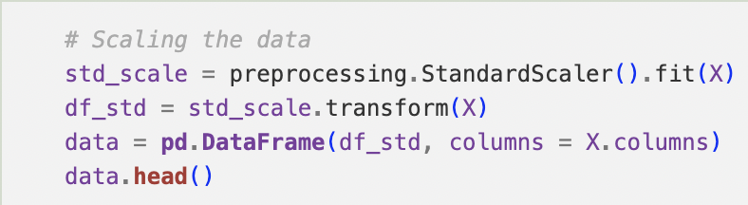
P A R T A : U N S U P E R V I S E D L E A R N I N G
DROPPING CLASS
DATA
PREPROCESSING
SCALING DATA
IMPORT DATA
EDA
PCA
K-MEANS
GMM
HIERACHICAL CLUSTERING
EVALUATION

Slide 6
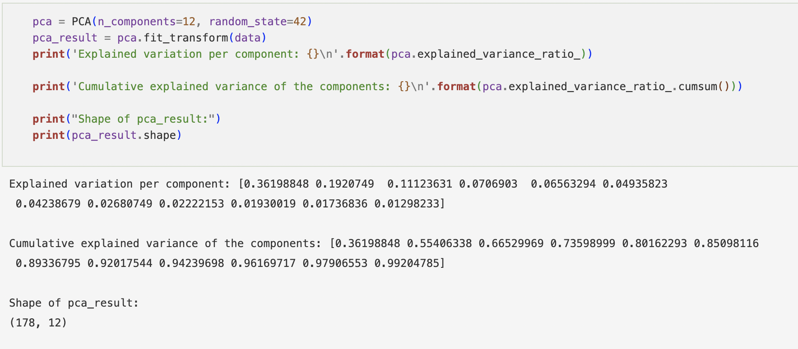
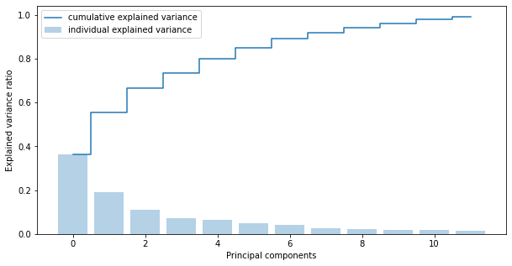
P A R T A : U N S U P E R V I S E D L E A R N I N G
IMPORT DATA
EDA
PCA
K-MEANS
GMM
HIERACHICAL CLUSTERING
EVALUATION
Notes:
Analysis of weightage of the components

Slide 7
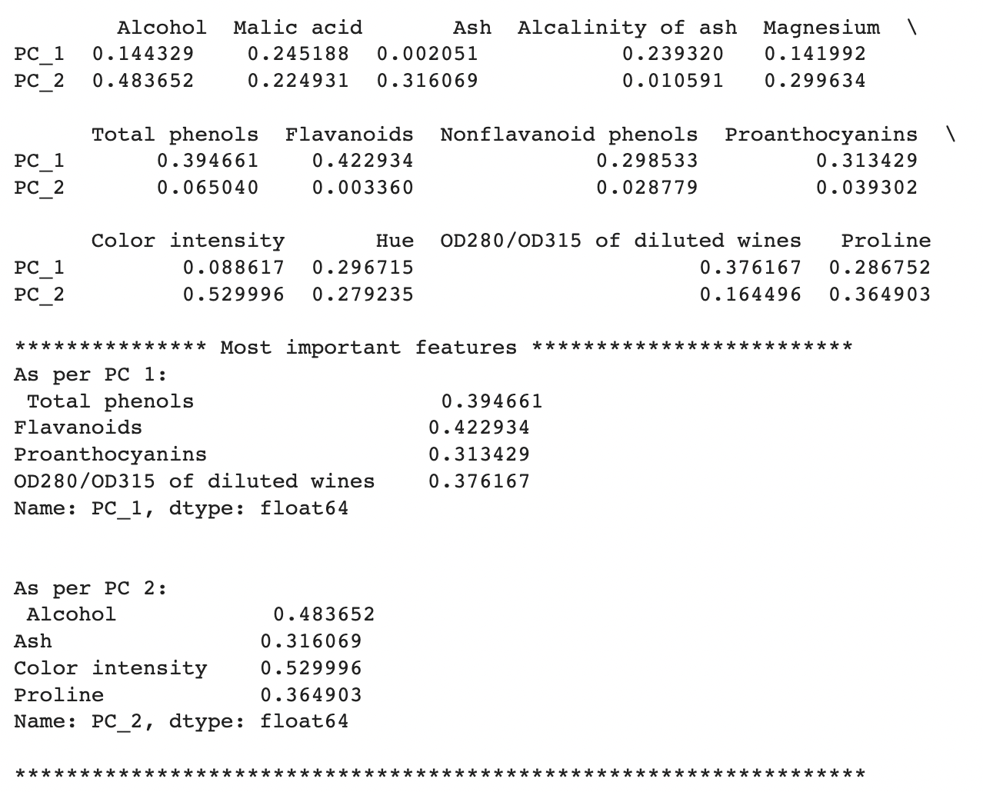
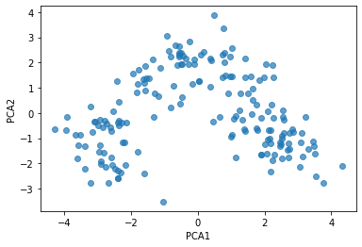
P A R T A : U N S U P E R V I S E D L E A R N I N G
Results
From pca
IMPORT DATA
EDA
PCA
K-MEANS
GMM
HIERACHICAL CLUSTERING
EVALUATION

Slide 8
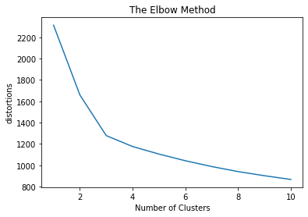
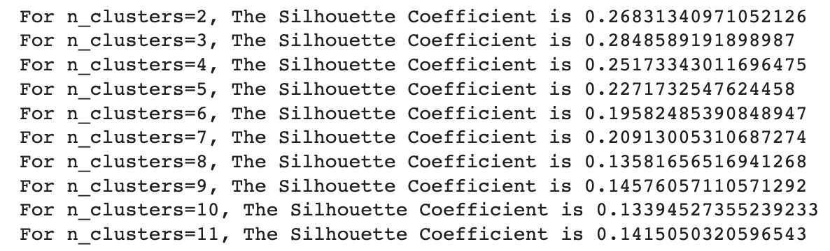
P A R T A : U N S U P E R V I S E D L E A R N I N G
Silhouette score
Most optimal score is 3
IMPORT DATA
EDA
PCA
K-MEANS
GMM
HIERACHICAL CLUSTERING
EVALUATION

Slide 9
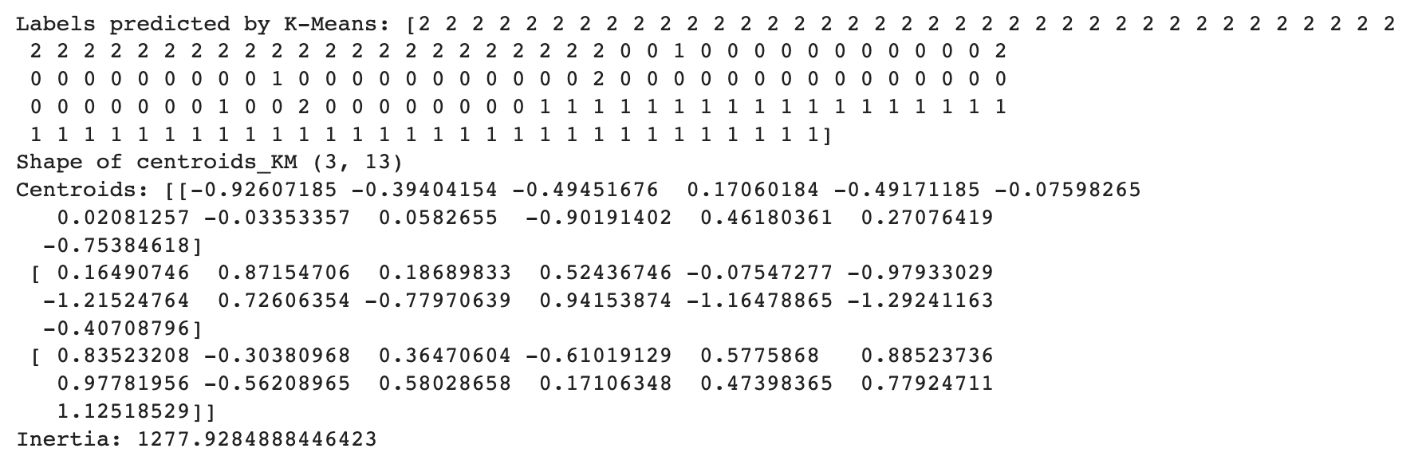
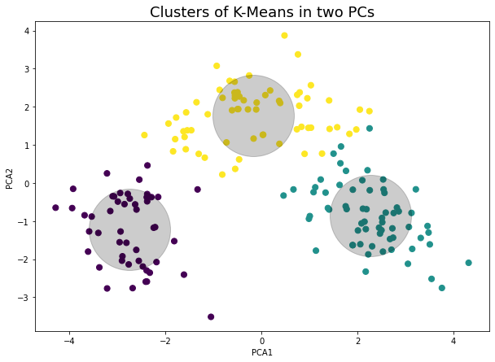
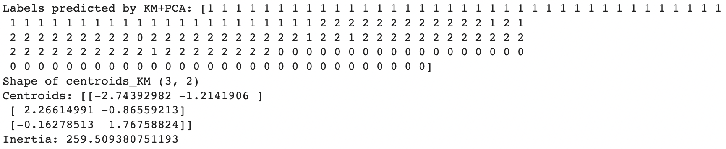
P A R T A : U N S U P E R V I S E D L E A R N I N G
kmeans
Kmeans + pca
IMPORT DATA
EDA
PCA
K-MEANS
GMM
HIERACHICAL CLUSTERING
EVALUATION

Slide 10
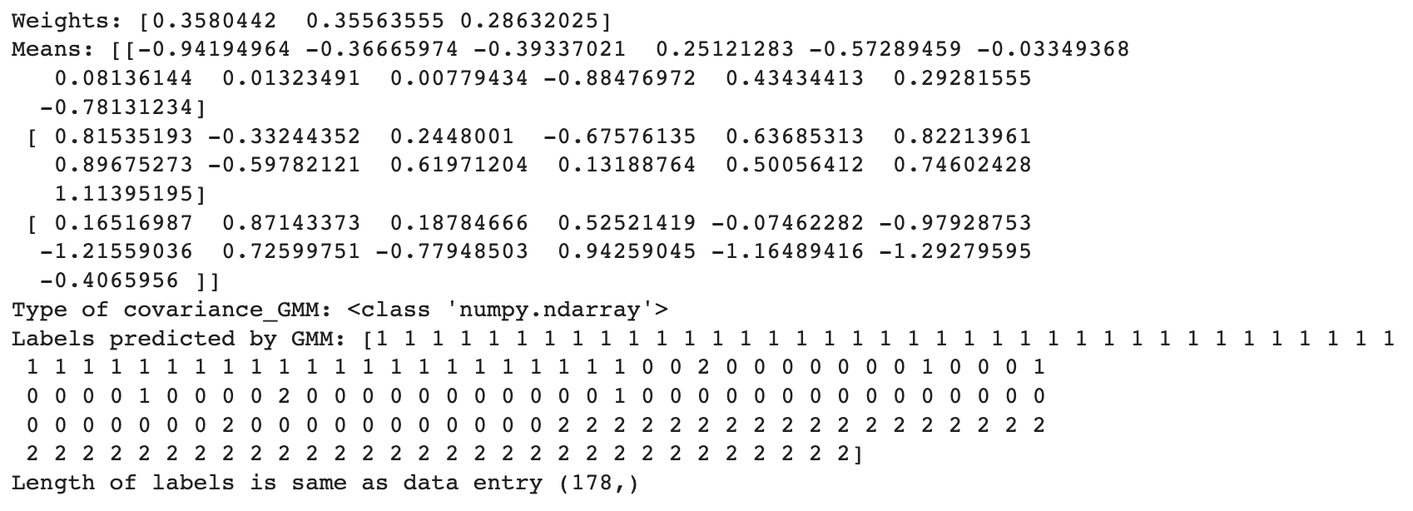
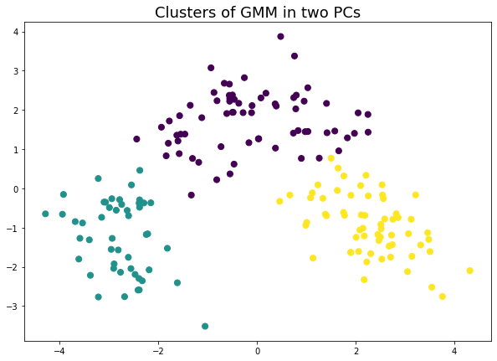
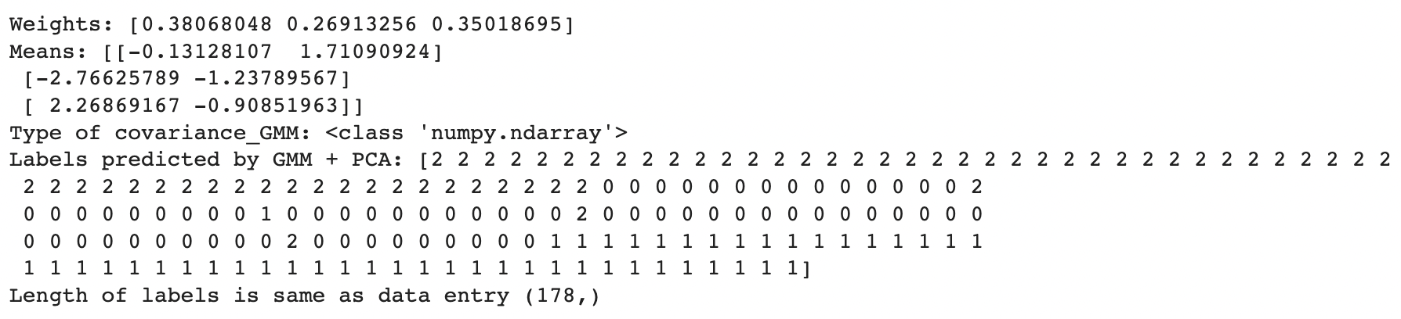
P A R T A : U N S U P E R V I S E D L E A R N I N G
Gaussian mixture model
Gaussian mixture model + pca
IMPORT DATA
EDA
PCA
K-MEANS
GMM
HIERACHICAL CLUSTERING
EVALUATION

Slide 11
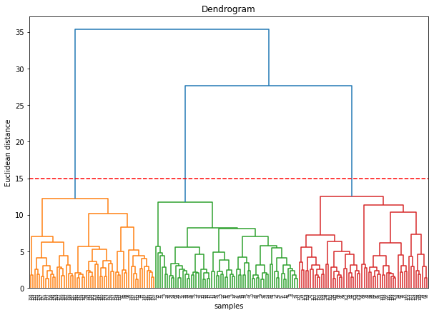
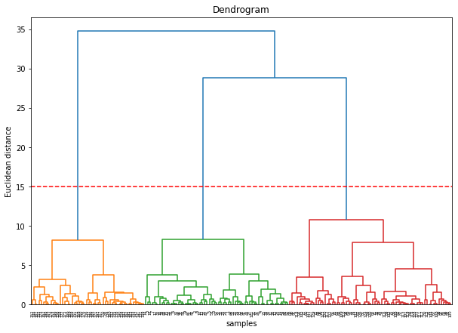
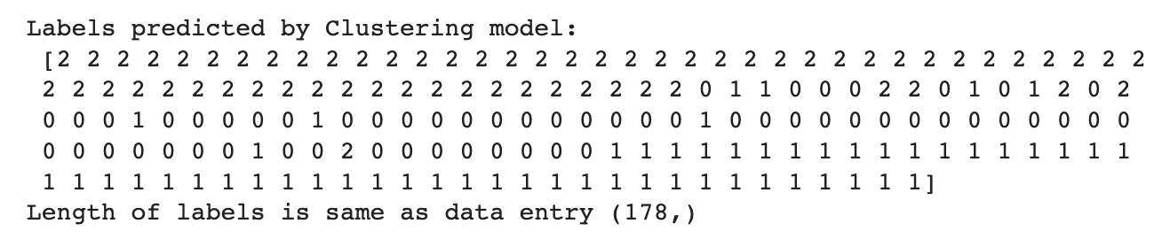
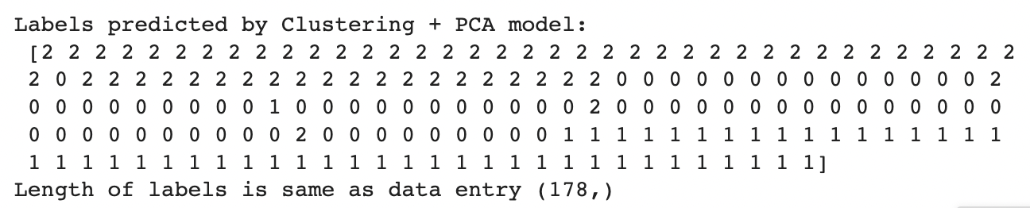
P A R T A : U N S U P E R V I S E D L E A R N I N G
Hierachical clustering
Hierachical clustering + pca
IMPORT DATA
EDA
PCA
K-MEANS
GMM
HIERACHICAL CLUSTERING
EVALUATION
Notes:
Best number of clusters is 3

Slide 12
P A R T A : U N S U P E R V I S E D L E A R N I N G
MODELS | SILHOUETTE SCORES | ADJUSTED RAND INDEX
KMEANS | 0.2849 | 0.8975
KMEANS + PCA | 0.2831 | 0.8951
GMM | 0.2844 | 0.8804
GMM + PCA | 0.2829 | 0.9135
HC | 0.2744 | 0.7899
HC + PCA | 0.2829 | 0.8960
IMPORT DATA
EDA
PCA
K-MEANS
GMM
HIERACHICAL CLUSTERING
EVALUATION
Notes:
GMM + PCA model yielded the best results

Slide 13
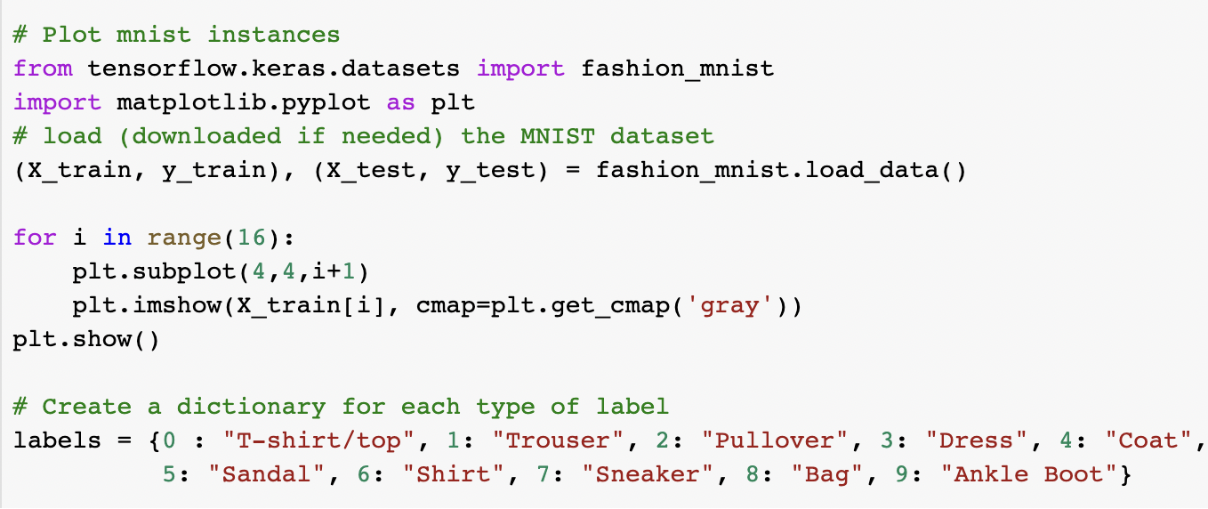
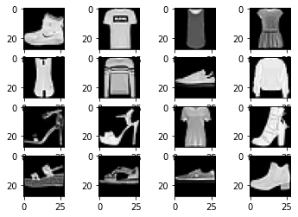
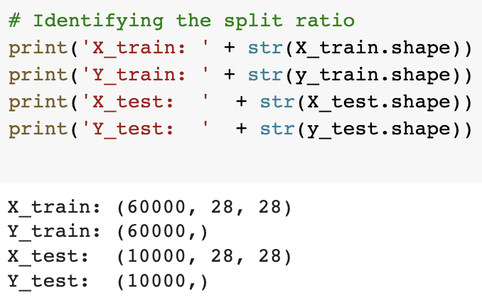
P A R T B : D E E P L E A R N I N G
IMPORT DATA
FEATURES ENGINEERING
SIMPLE MODEL
CNN MODEL
HYPERPARAMETER TUNING
EVALUATION
MAKiNG PREDICTIONS

Slide 14
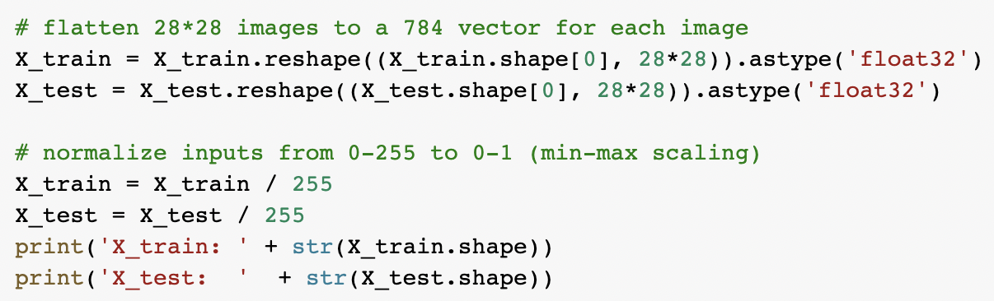
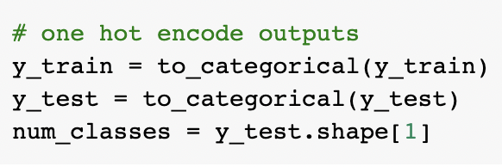
P A R T B : D E E P L E A R N I N G
Flatten images ->
Normalize inputs ->
Encode outputs ->
IMPORT DATA
FEATURES ENGINEERING
SIMPLE MODEL
CNN MODEL
HYPERPARAMETER TUNING
EVALUATION
MAKiNG PREDICTIONS

Slide 15
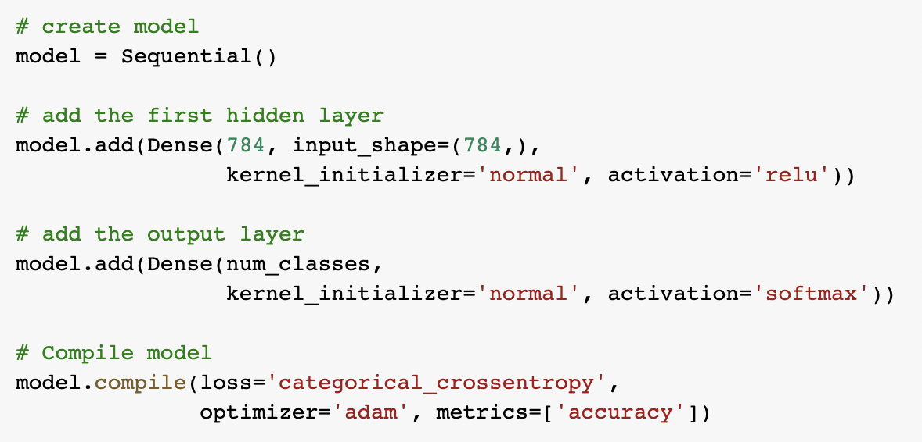
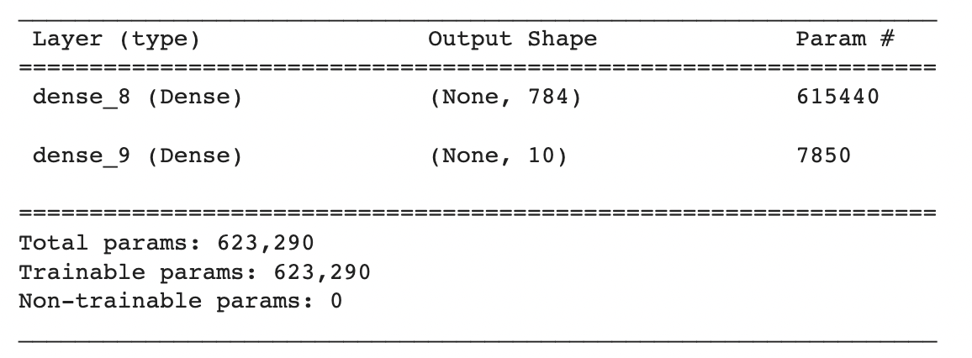
P A R T B : D E E P L E A R N I N G
IMPORT DATA
FEATURES ENGINEERING
SIMPLE MODEL
CNN MODEL
HYPERPARAMETER TUNING
EVALUATION
MAKiNG PREDICTIONS

Slide 16
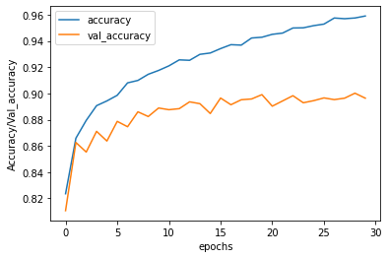
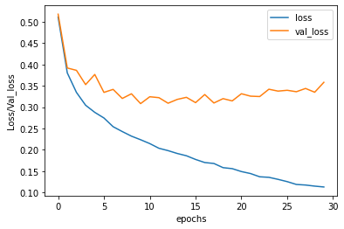
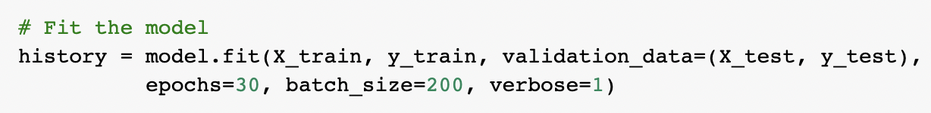
P A R T B : D E E P L E A R N I N G
Fit the model
Accuracy: 89.64% | baseline error: 10.36%
IMPORT DATA
FEATURES ENGINEERING
SIMPLE MODEL
CNN MODEL
HYPERPARAMETER TUNING
EVALUATION
MAKiNG PREDICTIONS
Notes:
Results after fitting and training the model

Slide 17
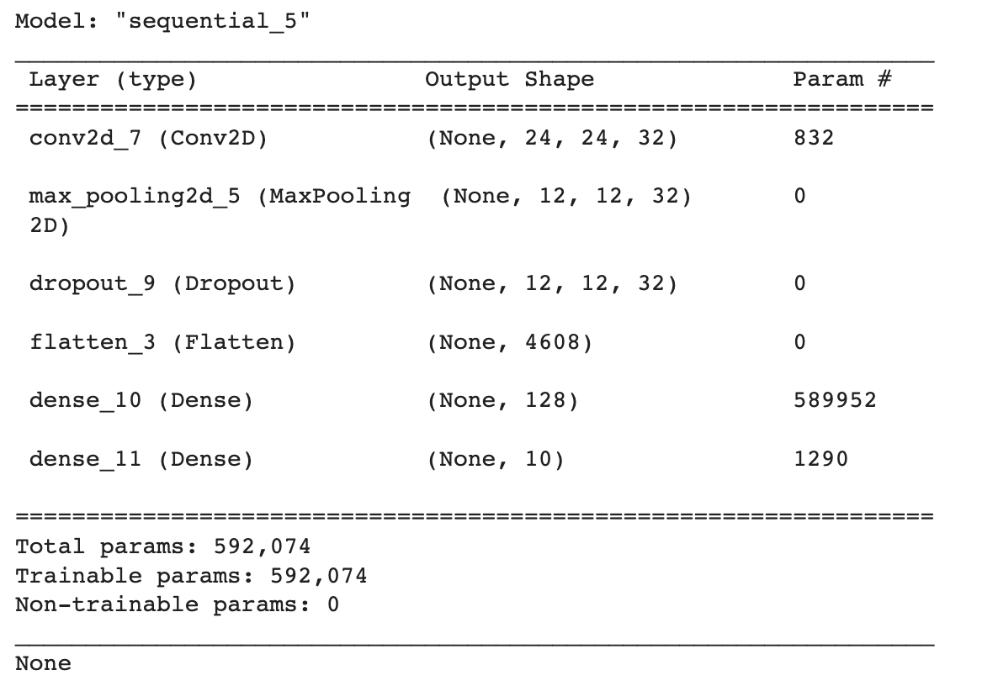
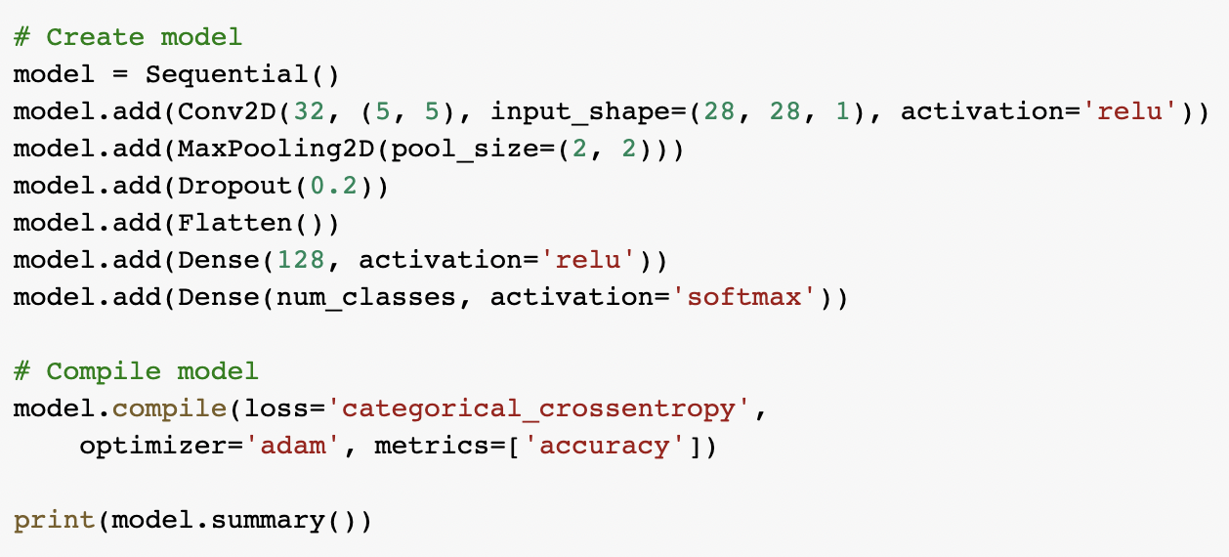
P A R T B : D E E P L E A R N I N G
IMPORT DATA
FEATURES ENGINEERING
SIMPLE MODEL
CNN MODEL
HYPERPARAMETER TUNING
EVALUATION
MAKiNG PREDICTIONS

Slide 18
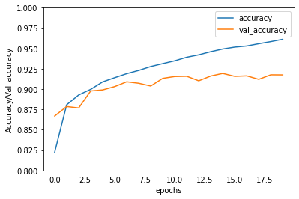
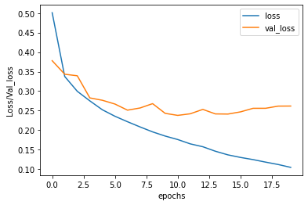
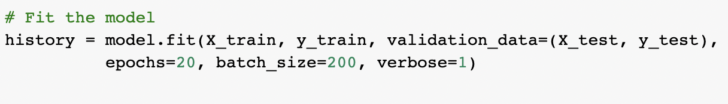
P A R T B : D E E P L E A R N I N G
Fit the model
Accuracy: 91.75% | baseline error: 8.25%
IMPORT DATA
FEATURES ENGINEERING
SIMPLE MODEL
CNN MODEL
HYPERPARAMETER TUNING
EVALUATION
MAKiNG PREDICTIONS
Notes:
Results after fitting and training the model

Slide 19
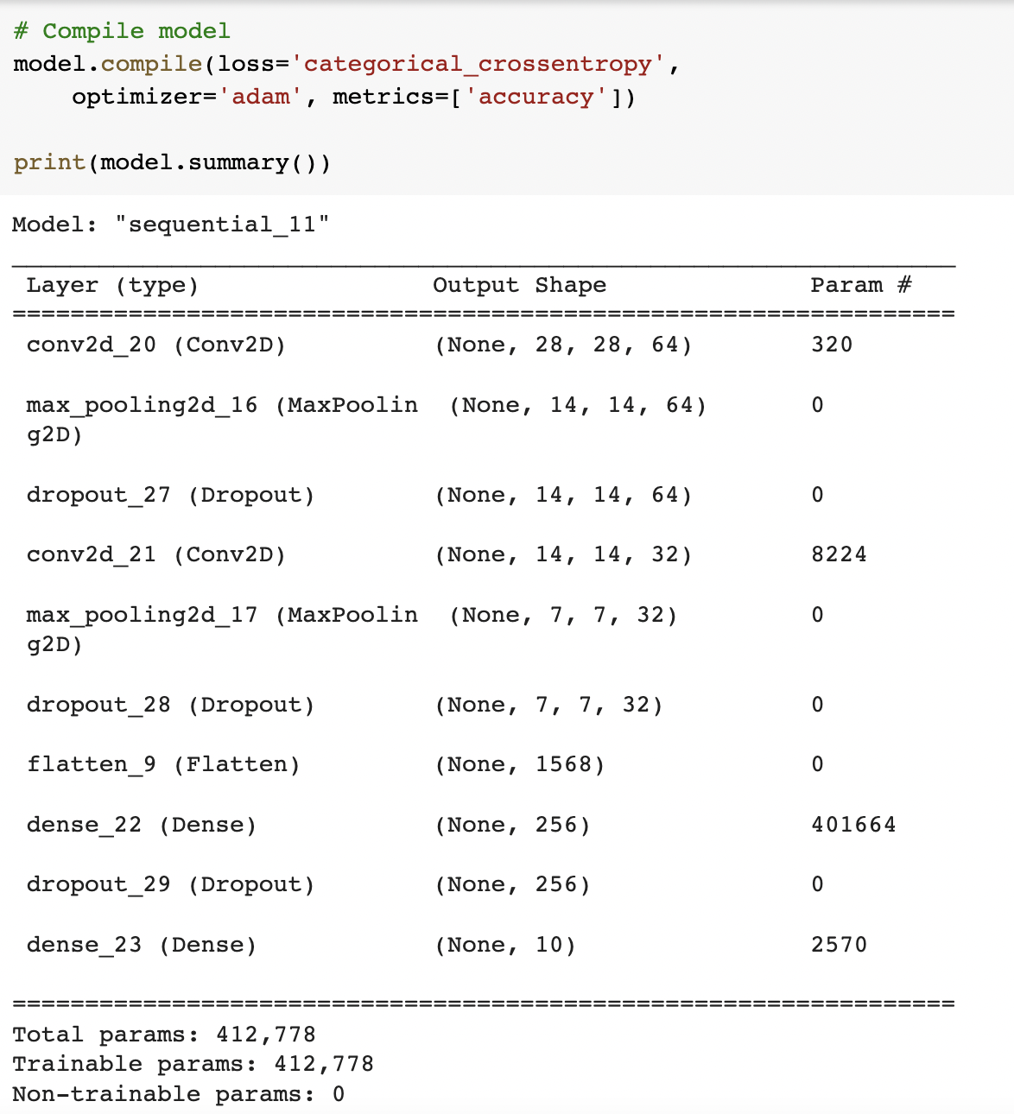
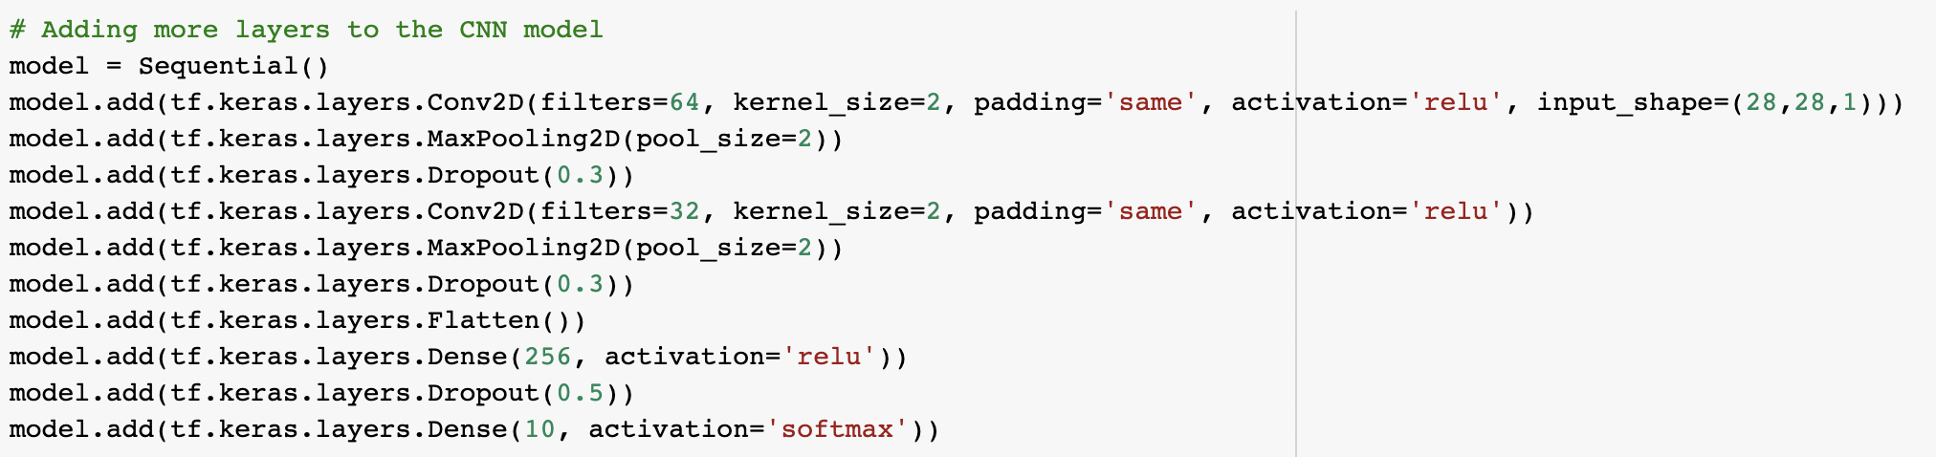
P A R T B : D E E P L E A R N I N G
New cnn model (after adding new layers)
IMPORT DATA
FEATURES ENGINEERING
SIMPLE MODEL
CNN MODEL
HYPERPARAMETER TUNING
EVALUATION
MAKiNG PREDICTIONS
Notes:
Adding more layers to the model to see if accuracy score becomes better

Slide 20
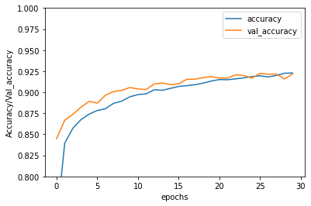
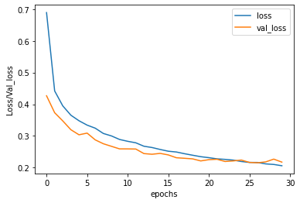
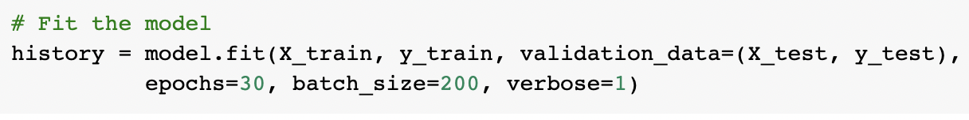
P A R T B : D E E P L E A R N I N G
Accuracy: 92.19% | baseline error: 7.81%
IMPORT DATA
FEATURES ENGINEERING
SIMPLE MODEL
CNN MODEL
HYPERPARAMETER TUNING
EVALUATION
MAKiNG PREDICTIONS
Notes:
Adding more layers to the model to see if accuracy score becomes better

Slide 21
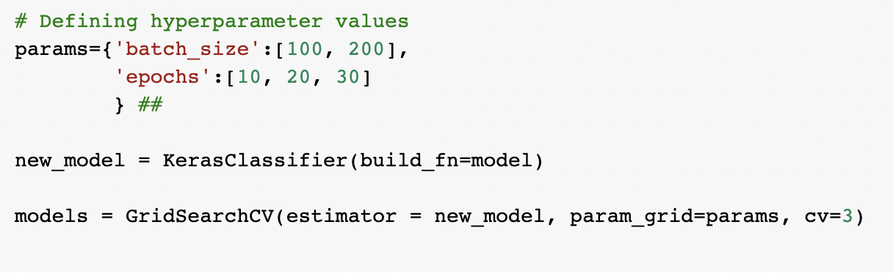
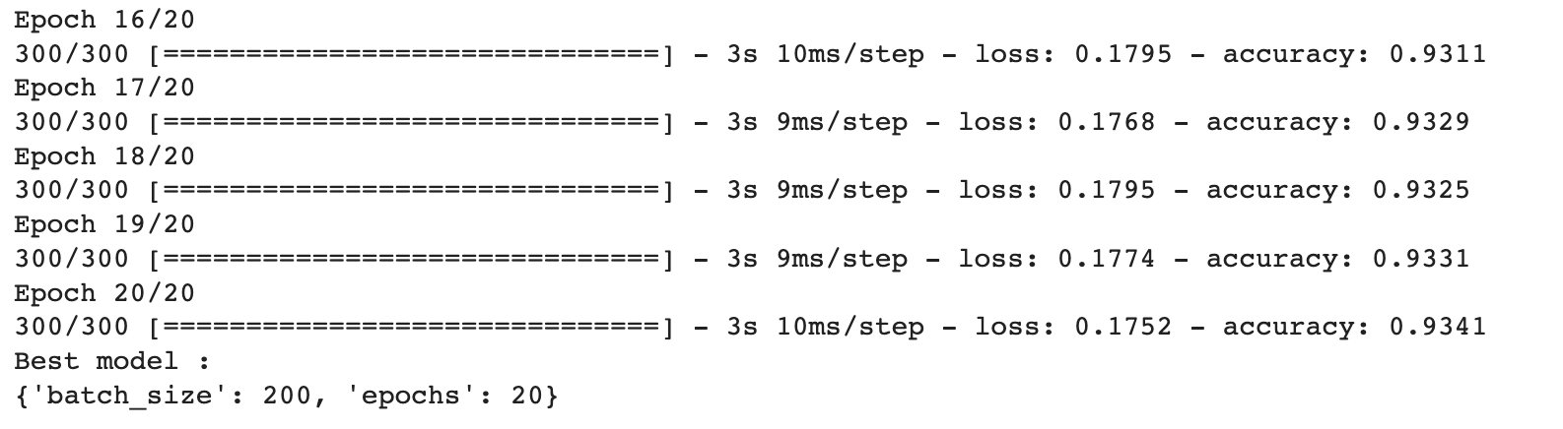
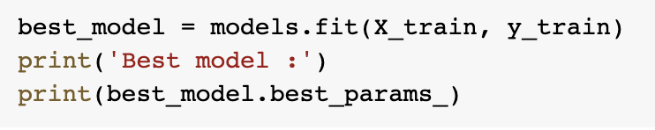
P A R T B : D E E P L E A R N I N G
Most optimal:
Batch size: 200
Epochs: 20
IMPORT DATA
FEATURES ENGINEERING
SIMPLE MODEL
CNN MODEL
HYPERPARAMETER TUNING
EVALUATION
MAKiNG PREDICTIONS

Slide 22
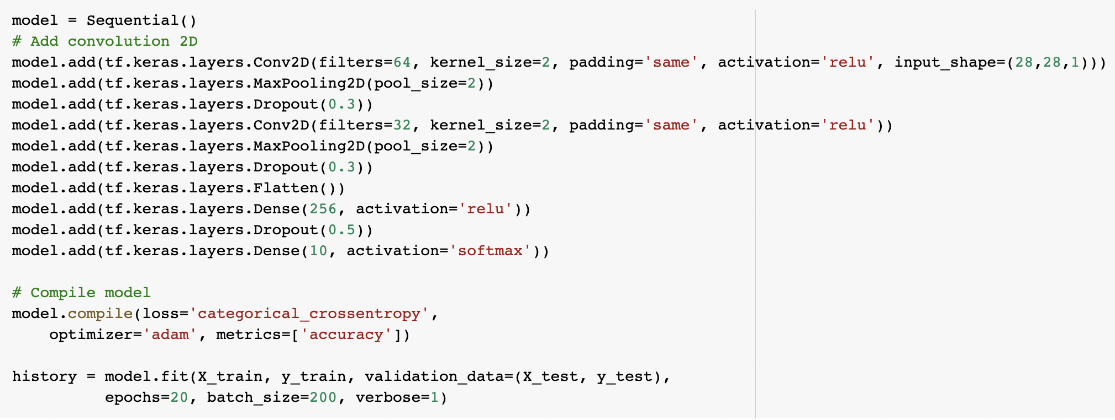
P A R T B : D E E P L E A R N I N G
Building a model based on hyperparameter results
Accuracy: 91.83% | baseline error: 8.17%
IMPORT DATA
FEATURES ENGINEERING
SIMPLE MODEL
CNN MODEL
HYPERPARAMETER TUNING
EVALUATION
MAKiNG PREDICTIONS

Slide 23


P A R T B : D E E P L E A R N I N G
Confusion matrix
IMPORT DATA
FEATURES ENGINEERING
SIMPLE MODEL
CNN MODEL
HYPERPARAMETER TUNING
EVALUATION
MAKiNG PREDICTIONS

Slide 24

P A R T B : D E E P L E A R N I N G
Prediction results on test dataset
IMPORT DATA
FEATURES ENGINEERING
SIMPLE MODEL
CNN MODEL
HYPERPARAMETER TUNING
EVALUATION
MAKiNG PREDICTIONS

Slide 25


P A R T B : D E E P L E A R N I N G
Correctly classified images
inCorrectly classified images
IMPORT DATA
FEATURES ENGINEERING
SIMPLE MODEL
CNN MODEL
HYPERPARAMETER TUNING
EVALUATION
MAKiNG PREDICTIONS
Notes:
Conclusion: Most of the images in the shirt category were wrongly classified as either T-shirt/top, pullover or coat. The model had the best accuracy scores in predicting bag, sneaker, trouser, ankle boot and sandal. This may be because these images had more distinct features as opposed to clothes, which are harder to distinguish, since most of the tops of different categories appeared similar in images.

